Slide 1
Introduction to Microprocessors

Slide 2
Why do we need to learn Microprocessors/Microcontrollers?
The microprocessor is the core of computer systems.
Its not an overstatement if it says that ,today there is no electronic gadget on the earth which is designed without a Microcontroller. Ex: communication devices, digital entertainment, portable devices etc…
Nowadays many communication, digital entertainment, portable devices, are controlled by them.

Slide 3
Why do we need to learn Microprocessors/Microcontrollers? (cont’d.)
Personal information products: Cell phone, pager, watch, pocket recorder, calculator
Laptop components: mouse, keyboard, modem, fax card, sound card, battery charger
Home appliances: door lock, alarm clock, thermostat, air conditioner, TV remote, VCR, small refrigerator, exercise equipment, washer/dryer, microwave oven
Industrial equipment: Temperature/pressure controllers, Counters, timers, RPM Controllers
Toys: video games, cars, dolls, etc.

Slide 4
Why do we need to learn Microprocessors/Microcontrollers? (cont’d.)
So, A good designer should always know what type of controller he/she is using ,their architecture, advantages , disadvantages , ways to reduce production costs and product reliability etc….

Slide 5
Microprocessor
Microprocessor and CPU are used interchangeably
A microprocessor is a multipurpose, programmable, clock-driven, register based electronic device that reads binary instructions from a storage device called memory, accepts binary data as input and processes data according to those instructions and provides results as output.

Slide 6
Microprocessor(cont’d.)
A CPU built into a single VLSI chip is called a microprocessor.
It is a general-purpose device and additional external circuitry are added to make it a microcomputer.
The microprocessor contains arithmetic and logic unit (ALU), control unit, Instruction register, Program counter (PC), clock circuit (internal or external), reset circuit (internal or external) and registers. But the microprocessor has no on chip I/O Ports, Timers, Memory etc.
For example, Intel 8085 is an 8-bit microprocessor and Intel 8086/8088 a 16-bit microprocessor.

Slide 7
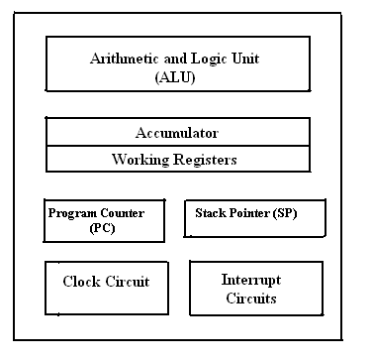
Microprocessor(cont’d.)
Fig. Block diagram of a Microprocessor.

Slide 8
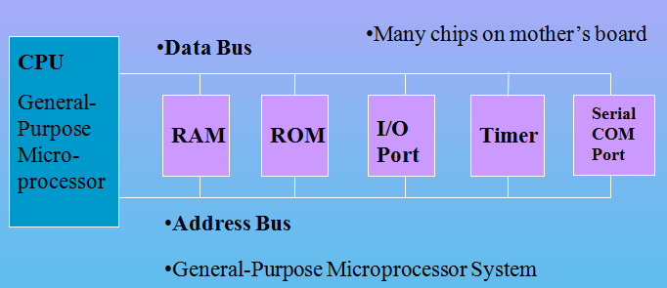
Microprocessor(cont’d.)
CPU for Computers
No RAM, ROM, I/O on CPU chip itself
Example: Intel's x86, Motorola’s 680x0

Slide 9
Microprocessor vs. Microcontroller (cont’d.)
Microprocessor
CPU is stand-alone, RAM, ROM, I/O, timer are separate
designer can decide on the amount of ROM, RAM and I/O ports.
expensive
general-purpose
High processing power
High power consumption
Instruction sets focus on processing-intensive operations
Typically 16/32/64 – bit
Typically deep pipeline (5-20 stages)
Microcontroller
CPU, RAM, ROM, I/O and timer are all on a single chip
fixed amount of on-chip ROM, RAM, I/O ports
for applications in which cost, power and space are critical
single-purpose (control-oriented)
Low processing power
Low power consumption
Bit-level operations
Instruction sets focus on control and bit-level operations
Typically 8/16 bit
Typically single-cycle/two-stage pipeline
Notes:
versatility 多用途的: any number of applications for PC

Slide 10
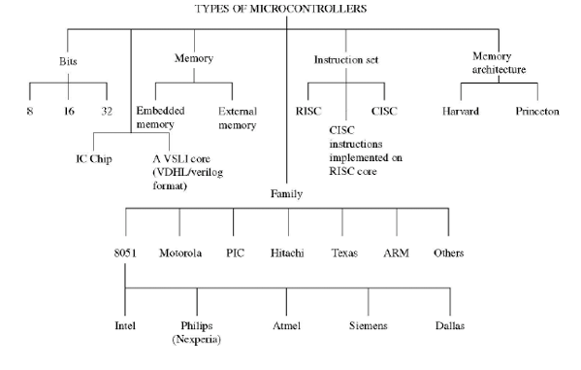
Types

Slide 11
Thank You

